Slide 1
Self-esteem

Slide 2
What is Self-Esteem
You might have heard and seen similar words like “self-image,” “self-perception,” and “self-concept.” All these terms refer to the way we view and think about ourselves. As human beings, we have the ability to not only be aware of ourselves but also to place a value or a measure of worth to ourselves or aspects of ourselves. So, self-esteem usually refers to how we view and think about ourselves and the value that we place on ourselves as a person

Slide 3
Before we go further, take a few minutes to write a short description of yourself.
How did you describe yourself? What words did you use? Is your description of yourself generally positive, balanced, or negative?

Slide 4
What is Low Self-Esteem
Do you ever think that you are weak, stupid, not good enough, inferior to other people, useless, worthless, unattractive, ugly, unlovable, a loser, or a failure? Everyone uses these words on themselves at times, usually when they experience a challenging or stressful situation. However, if you often think about yourself in these terms, then you might have a problem with low self-esteem.

Slide 5
Low self-esteem is having a generally negative overall opinion of oneself, judging or evaluating oneself negatively, and placing a general negative value on oneself as a person.
Example:
“I’m overweight. I am so fat and ugly.” “I’m unimportant.” “I’m a loser.” “I’m unlovable.”
“I’m not good enough.”

Slide 6
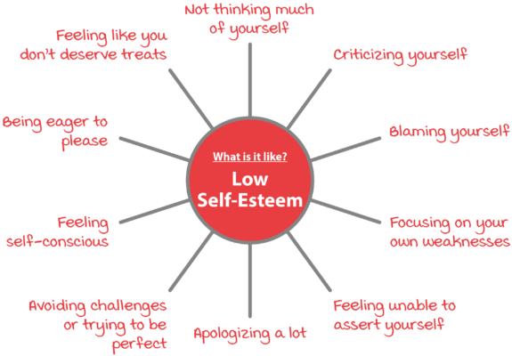

Slide 7
Impact of Low Self-Esteem
They might criticise themselves
their actions, and abilities or joke about themselves in a very negative way.
They might put themselves down, doubt themselves, or blame themselves when things go wrong. Often, they might not recognise their positive qualities

Slide 8
People with low self-esteem might expect that things would not turn out well for them.
They might often feel sad, depressed, anxious, guilty, ashamed, frustrated, and angry.
Low self-esteem can also have an impact on many aspects of a person’s life.
It can affect a person’s performance. They might consistently achieve less than they are able to because they believe they are less capable than others. They might avoid challenges for fear of not doing well.

Slide 9
In their personal relationships, people with low self-esteem might become upset or distressed by any criticism or disapproval, be extremely shy or self-consciousness or even avoid or withdraw from social contact.
They might also be less likely to stand up for themselves or protect themselves from being bullied, criticised, or abused by their partners or family members.

Slide 10
How Low Self-Esteem Develops
Punishment, Neglect, or Abuse
How we were treated earlier in life affects the way we see ourselves and who we are. If children are mistreated, punished frequently in an extreme or unpredictable manner, neglected, abandoned, or abused, these experiences can leave some emotional and psychological scars. It is not surprising, then, that a person who has had these sorts of experiences in their earlier life can come to believe very negative things about themselves.

Slide 11
Difficulty in Meeting Parents’ Standards
If your parents, and family members often focused on your weaknesses and mistakes and rarely acknowledged your positive qualities or successes (perhaps saying things such as “You could have done better,” or “That’s not good enough”), or if they frequently teased you, made fun of you, and put you down, you might also come to believe some negative things about yourself.

Slide 12
Not Fitting In at Home or at School
Some people may have experienced being the ‘odd one out’ at home or at school. They might have been less intelligent than their siblings at home or had different interests, talents or skills to others in the family (such as being artistic, musical, sporty or love mathematics, science, arts). Although they might not have been criticised for their different interests or abilities, these might not have been acknowledged. At the same time, the activities or achievements of their siblings or peers might have been praised or celebrated. As such, they might come to believe thoughts such as “I’m weird,” “I’m odd,” or “I’m inferior.”

Slide 13
Being on the receiving end of other people’s stress or distress
When families experience stressful or distressing life events, parents may need to give their attention to dealing with the problems that have occurred. As such, parents may not be able to give much attention to their child or children. It is also possible that parents or carers in such circumstances become frustrated, angry, anxious, or depressed and respond negatively towards their children or become role models of unhelpful behaviour.

Slide 14
What early experiences did you have that might have contributed to the way you view, and feel about, yourself? Take a bit of time to jot down a brief description of those experiences.

Slide 15
Protecting Ourselves: Rules & Assumptions
We might develop rules such as:
“I must be the best at everything.”
“I must never make any mistakes.”
“I must always do the right thing.”

Slide 16
We might also develop assumptions such as:
“If I ask for something I need, I will be put down.”
“No matter what I do, it will never be good enough.”
“If I can’t control my food intake, I will never be able to control anything in my life.”

Slide 17
Rules and assumptions can also be combined, for example:
“I won’t try anything unless I know that I can do it perfectly, because if I can’t, it means I’m a total failure.”
“I have to always be slim and dress well, or else I will never be accepted.”

Slide 18
How Low Self-Esteem Begins
Negative Life Experiences
Negative Core Beliefs about Yourself
Unhelpful Rules & Assumptions
Unhelpful Behaviour

Slide 19
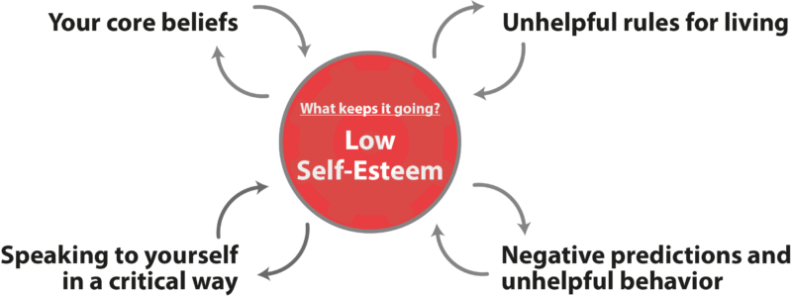

Slide 20
Self-esteem: Take steps to feel better about yourself

Slide 21
Focusing On the Positive You
when you have low self-esteem, you have a tendency to only pay attention to negative things that confirm your negative view of yourself.
You rarely pay attention to the positive things you do, your positive qualities, positive outcomes or positive comments from others.

Slide 22
Positive Qualities Record
Make a list of the positive aspects of yourself, including all your good characteristics, strengths, talents, and achievements, and record them.

Slide 23
To help you make a list of your positive qualities, ask yourself the following questions:
• What do I like about who I am?
• What characteristics do I have that are positive?
• What are some of my achievements?
• What are some challenges I have overcome?
• What are some skills or talents that I have?
• What do others say they like about me?
• How might someone who cared about me describe me?
• What do I think are bad qualities? What bad qualities do I not have

Slide 24
Become aware of thoughts and beliefs
Once you've learned which situations affect your self-esteem, notice your thoughts about them. This includes what you tell yourself (self-talk) and how you view the situations.
Your thoughts and beliefs might be positive, negative or neutral. They might be rational, based on reason or facts. Or they may be irrational, based on false ideas.
Ask yourself if these beliefs are true. Would you say them to a friend? If you wouldn't say them to someone else, don't say them to yourself

Slide 25
Challenge negative thinking
Your initial thoughts might not be the only way to view a situation. Ask yourself whether your view is in line with facts and logic.
Be aware that it can be hard to see flaws in your logic. Long-held thoughts and beliefs can feel factual even if they're opinions.

Slide 26
Adjust your thoughts and beliefs
Now replace negative or untrue thoughts with positive, accurate thoughts. Try these strategies:
Use hopeful statements. "Even though it's tough, I can handle this."

Slide 27
Forgive yourself. "I made a mistake, but that doesn't make me a bad person."
Avoid 'should' and 'must' statements.
Relabel upsetting thoughts. Think of negative thoughts as signals to try new, healthy patterns. Ask yourself, "What can I think and do to make this less stressful?"

Slide 28
Encourage yourself. Give yourself credit for making positive changes. For example, "My presentation might not have been perfect, but my classmates asked questions and remained engaged. That means I met my goal."

Slide 29
Stop second guessing
If you feel bad around toxic people, you shouldn’t just take the abuse because of you show signs of self esteem problems. Instead, you should cut those people out. It’s easier to improve confidence, when you make a firm decision.

Slide 30
Live in the now
learn to live in the present and not let the hurts of your past or worries about the future affect your actions. You can achieve this by engaging all your five senses – stop and listen for melodious sounds of birds, feel the breeze of air on your skin, smell the freshness of the air, enjoy the beautiful color of the sky. All these will draw your consciousness into the present and help you have the right frame of mind when making day-to-day decisions.

Slide 31
Surround yourself with positive people
What we see and hear about ourselves significantly affects our self esteem. And sometimes, those things may have a permanent effect. Believe it or not, the people you surround yourself or interacted with in the past have contributed to the person you are today.
Spend time with positive people. Start attending conferences with people who want you to be better and who will push to do the impossible.

